Slide 1
Autonomous Drone Delivery System for Industry 4.0
Progress Report
Student Name: Jianhui Li
Supervised by: Dr. Tengyuan Zhang & Prof. Jun Yang
Submission Date: July 13rd, 2018

Slide 2
Progress
Use c++ programming code Linux system, build in raspberry PI
Write a script when raspberry pi reboot, executive the take-off program.
Successfully control guidance by using Raspberry PI.
Solve compatible problem between guidance and raspberry PI

Slide 3
Objectives
Control the drone to fly to a specific position when raspberry PI connecting to the power supply (when the raspberry pi reboot)
Read the digital signal from the guidance

Slide 4
Reading/Literature Review
If you did any reading/literature review in the past two weeks, then:
DJI Guidance SDK tutorial
Raspberry PI automatically reboot script.
DJI onboard API: https://developer.dji.com/onboard-api-reference/index.html
DJI guidance SDK

Slide 5
Current Challenges/Discussion
Using SSH to link Raspberry PI with PC as usual. In the etc/rc.local, I tried to write a script to start a program when the PI reboot. When the drone activates, the order can send to the drone automatically. The second challenge comes from guidance SDK, which is a old version provided by DJI, and doesn’t work right now. It takes much time to find the bug

Slide 6
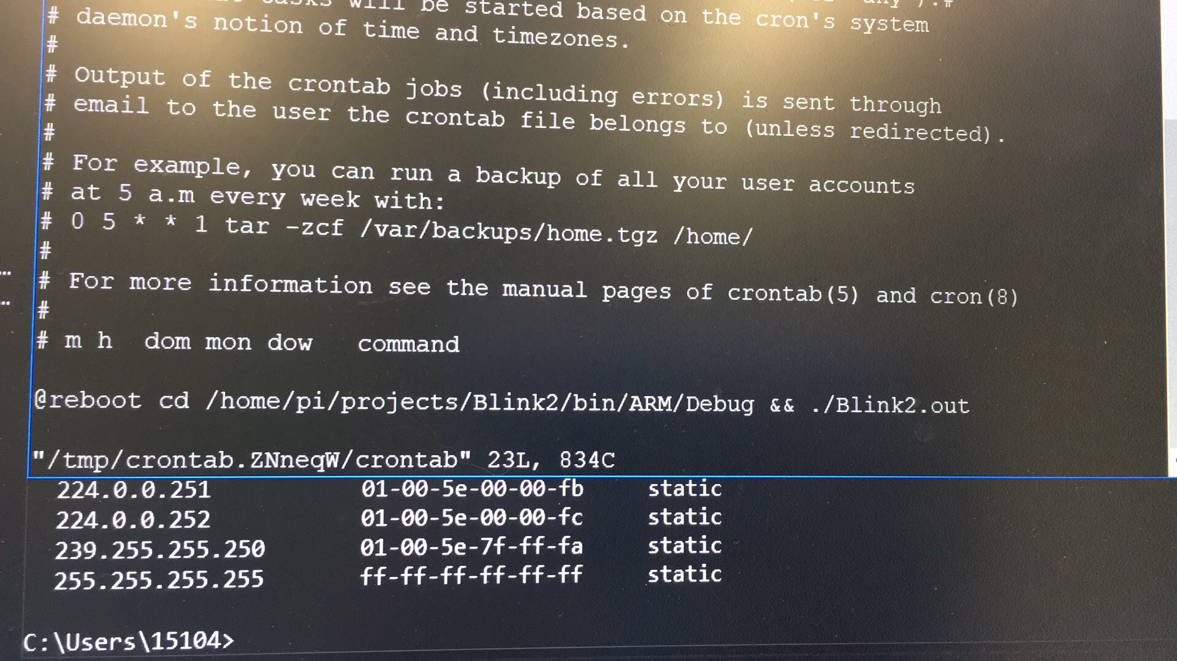
Lab 1: Raspberry Pi start-up test
Introduction:
When the raspberry pi reboot, a start-up script should work.

Slide 7
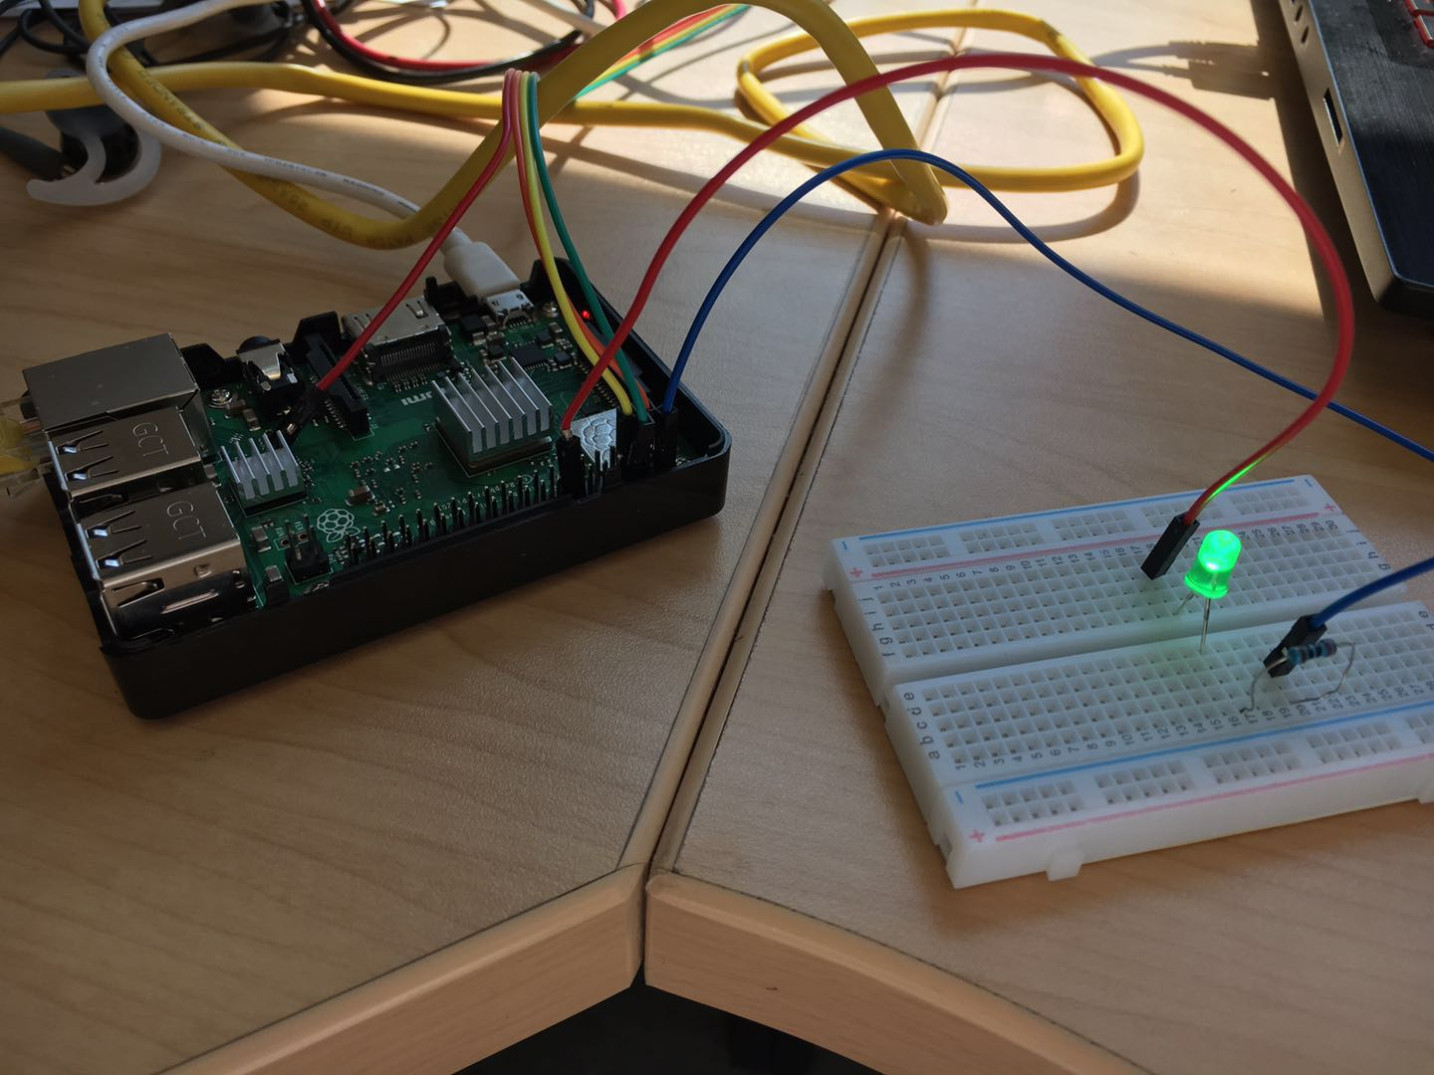
Progress:
Write a script named testboot.sh
Add the /home/pi/direction to the rc.local or using crontab
Using nano, vim to edit system file
Reboot PI
Obverse the LED blink test works

Slide 8
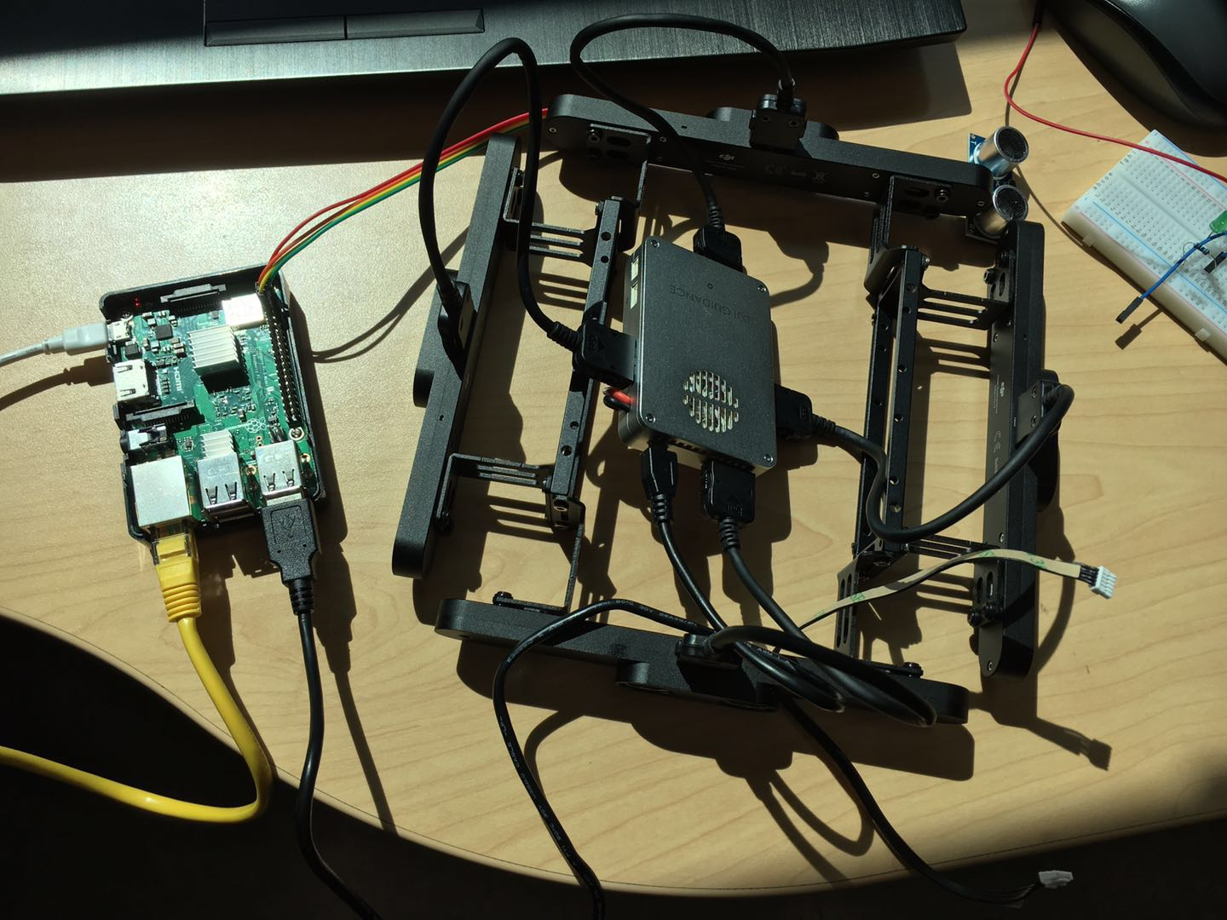
Lab 2: Raspberry Pi read digital signal from DJI
Introduction:
The Guidance-SDK can support much data about the fly-situation. We need to setup the executive environment in Linux system

Slide 9
Progress:
Download libusb-1.0.9 library in raspberry pi
Download opencv 2.4.9 in PI.
Copy libDJI_guidance.so to “library file path” of your project. And Copy DJI_guidance.h to “header file path”. In this step, the error is about lib document does not work in Linux. Besides, the arm structure version’s lib is too old. We need to use XU3 version.
Read the distance and other type data from the guidance

Slide 10
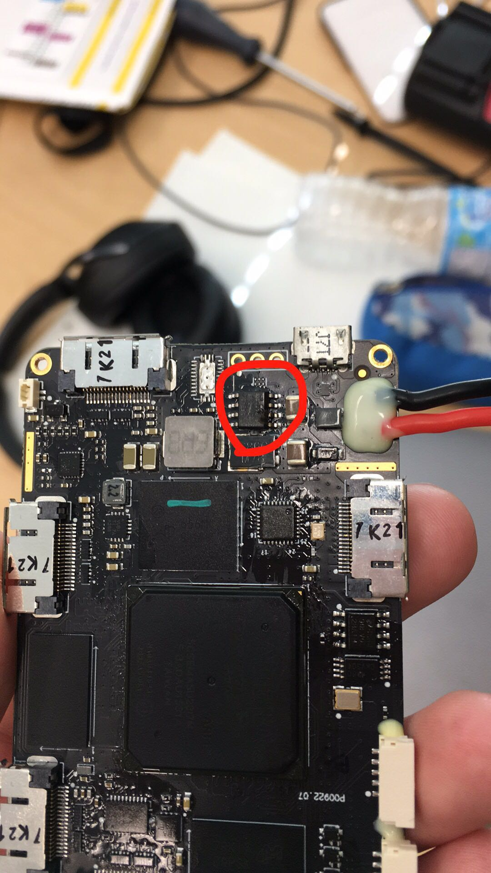
Result:
When connected to DC power, the power supplied from 5 volts. And then it increase to 15 volts. The guidance core was burned. The damaged part is MOSFET, which is used to protect the centre circuit and works as dc-dc converter. The reason is doubt to be varying current burning the MOSFET.

Slide 11
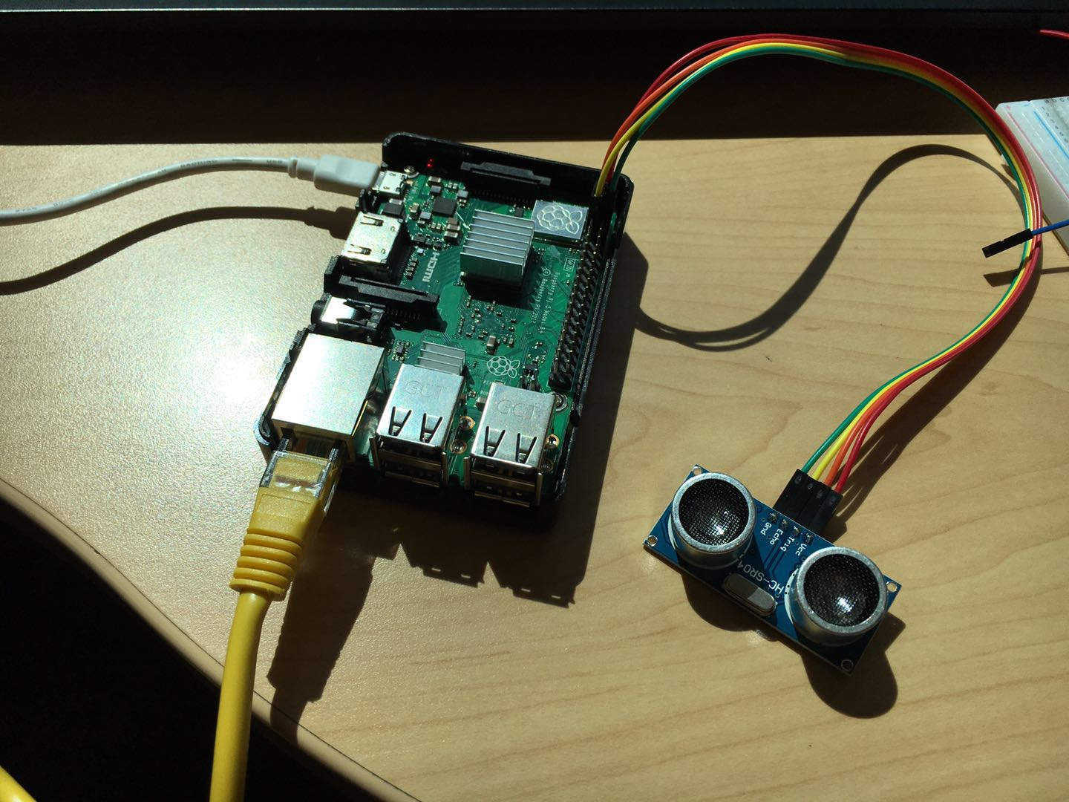
Lab 3: Raspberry Pi read ultrasonic signal
Introduction:
If the guidance cannot repair in the next several weeks, the ultrasonic sensor and camera are designed to replace the guidance

Slide 12
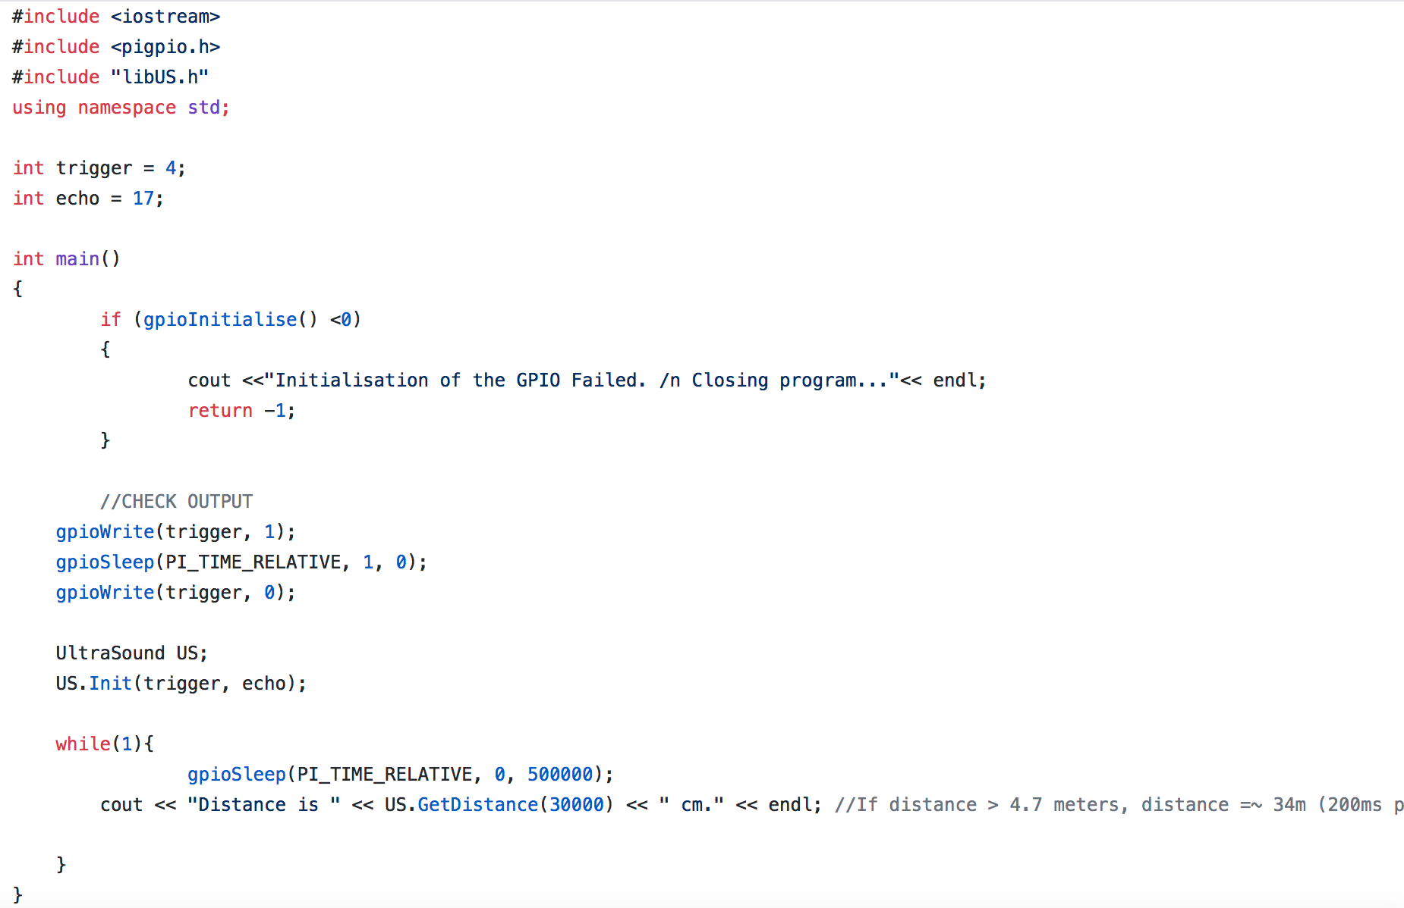
Progress:
Setup environment, and open i2c function in raspi-config
Change the complier from gdbserver to gdb in VS Linux development environment
Need to remove noise of the sensor and filter the signal

Slide 13
Summary
In the last two weeks, learning and solving problem takes much time. The effective method is to learn project online, and sloving problem using google and stackflow. They support many solved answer to public.
If still cannot solve the problem, do not hesitate to ask people or find help from others.

Slide 14
Future Plan
There is 6 weeks left. In the next two weeks, fixing the guidance system is the first task. If the guidance can be fixed, using ROS, or Google GPRC is good method to let the data communicate within rapsberry pi. Because, we can get more accurate control of the drone. The left time is designed to learn using opencv, and how to eliminate error of drone’s movement

